Slide 1
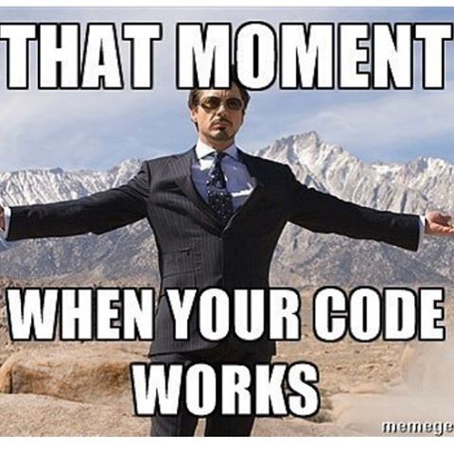

Slide 2
The Aggregation Pipeline cont’d
NoSQL Databases (DSO-553)
Prof: Arsames Qajar

Slide 3
Overview
Review Homework and questions
Review MongoDB & Aggregation
Aggregation Pipeline cont’d

Slide 4
MongoDB - Aggregation Pipeline Review

Slide 5
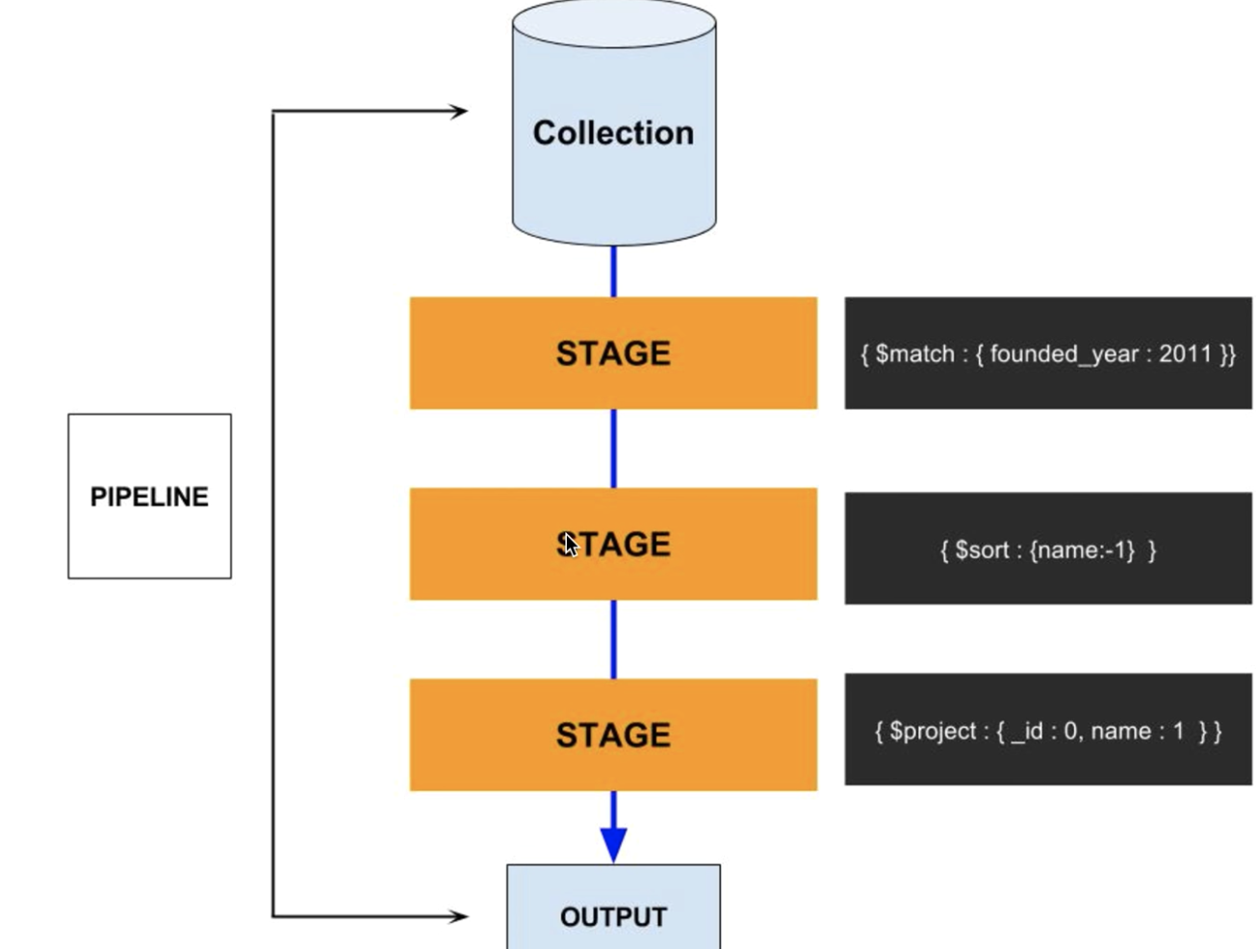
The Agg. Pipeline

Slide 6
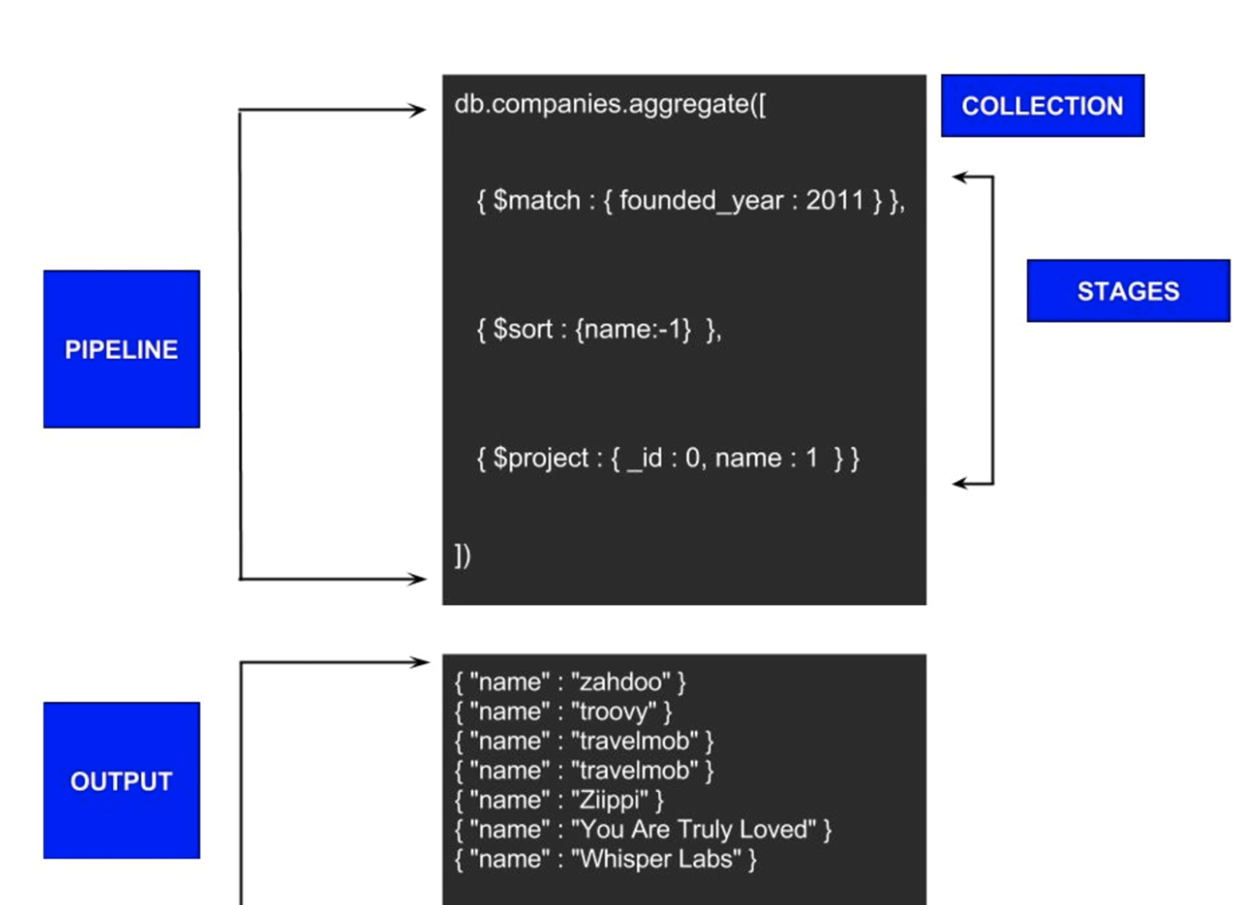
The Agg. Pipeline

Slide 7
Neo4j

Slide 8
4 Building Blocks
Vertices/Nodes
Labels
Properties
Edges/Relationships
Notes:
What is Graph? What are vertices(nodes) with properties, and edges i.e. relationships
Very nature is interconnected
Networks
Node - can have mlutiple lables
What are some use cases?

Slide 9
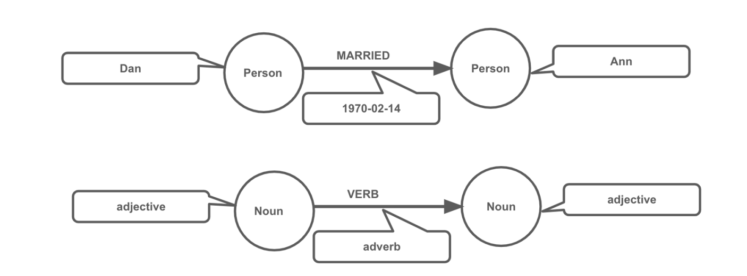
Structure: Neo4j to English Sentence
Notes:
What is Graph? What are vertices(nodes) with properties, and edges i.e. relationships
Very nature is interconnected
Networks
Node - can have mlutiple lables
What are some use cases?

Slide 10
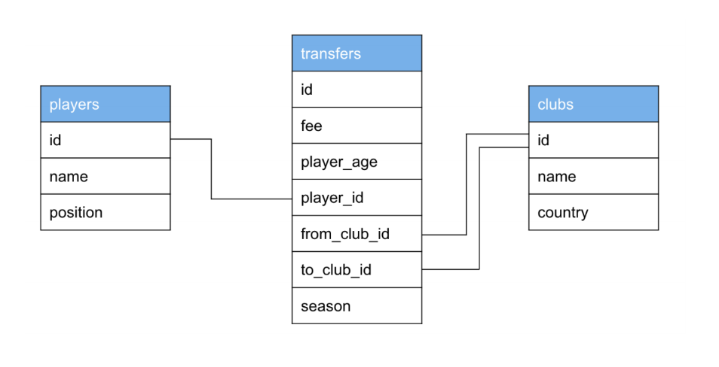
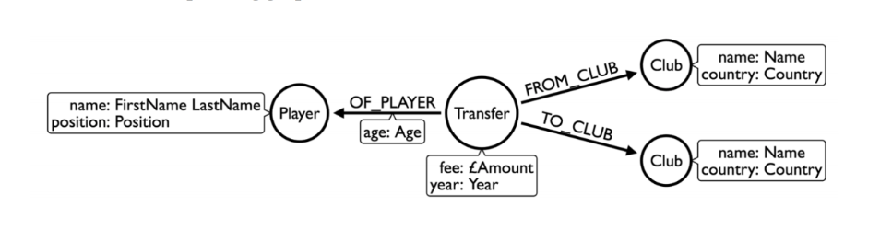
Relational Model
Graph Model
Notes:
What is Graph? What are vertices(nodes) with properties, and edges i.e. relationships
Very nature is interconnected
Networks
Node - can have mlutiple lables
What are some use cases?

Slide 11
Resources

Slide 12
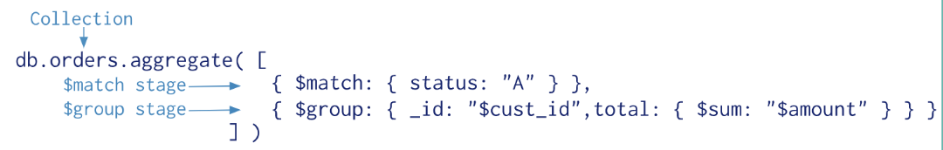
The Agg. Pipeline

Slide 13
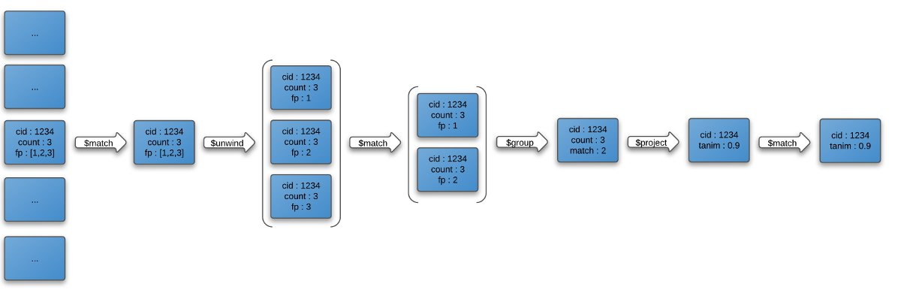
The Pipeline - example 2

